Slide 1

Learning from multiple tasks
Transfer learning
deeplearning.ai

Slide 2
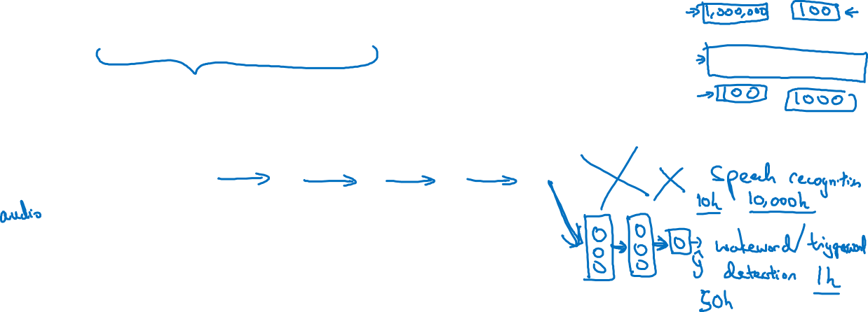


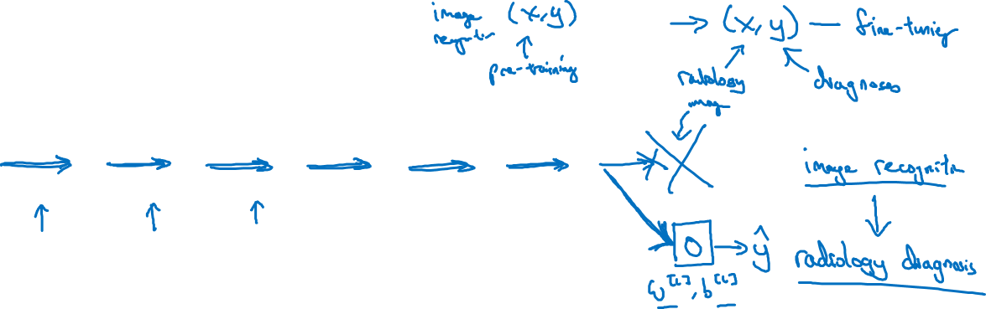
Transfer learning
x
$$\hat{y}$$
x
$$\hat{y}$$

Slide 3
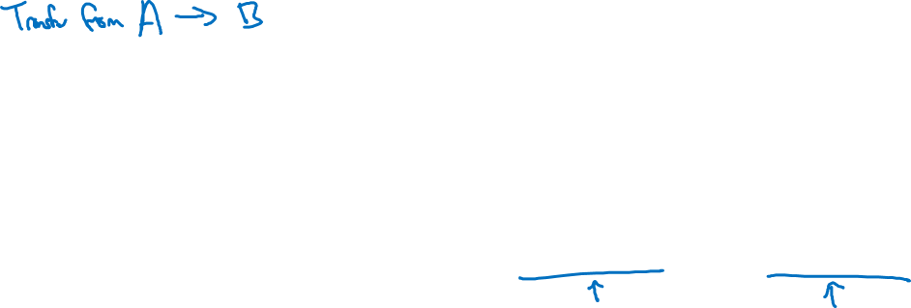
When transfer learning makes sense
Task A and B have the same input x.
例如，都是语音、都是图片、……
You have a lot more data for Task A than Task B.
Low level features from A could be helpful for learning B.

